Slide 1
Fixing Cross-Origin (CORS) Errors
James Xue
COMS4170

Slide 2
Example Request
Works in your browser!
Try it yourself: https://geocoding.geo.census.gov/geocoder/locations/onelineaddress?address=4600+Silver+Hill+Rd%2C+Suitland%2C+MD+20746&benchmark=9&format=json

Slide 3
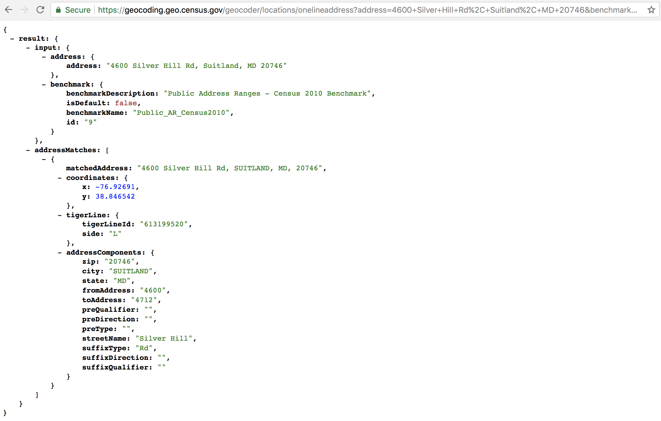

Slide 4
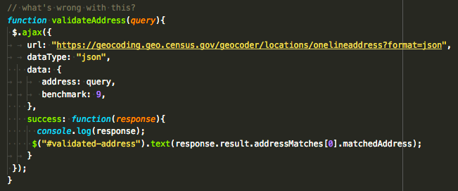
What’s wrong with this?

Slide 5
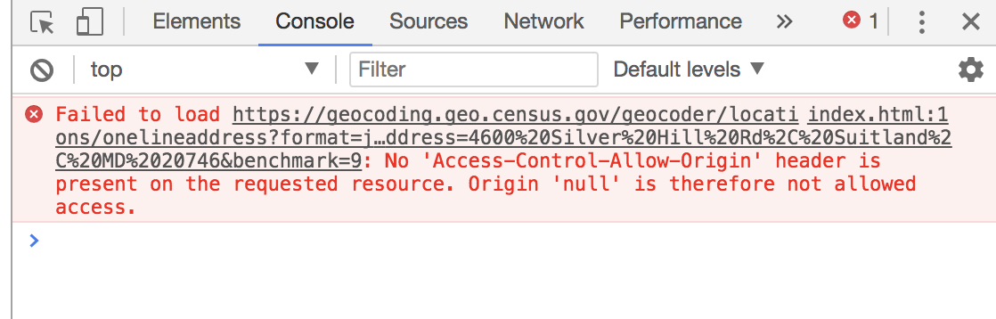
But… CORS error!

Slide 6
Why?
CORS = cross origin resource sharing
Allows restricted resources on a web page to be requested from another domain outside the domain from which the first resource was served
Common when working with APIs. Some StackOverflow questions

Slide 7
A nice hack: JSONP
The Geocoding API provides JSONP support
“The advent of JSONP — essentially a consensual cross-site scripting hack — has opened the door to powerful mashups of content. Many prominent sites provide JSONP services, allowing you access to their content via a predefined API.”
Enables sharing of data bypassing same-origin policy
More details

Slide 8
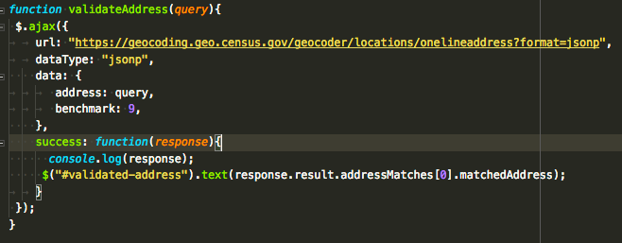
JSONP Fix

Slide 9
Check out the code
https://github.com/frogbandit/COMS4170-teaching

